Slide 1
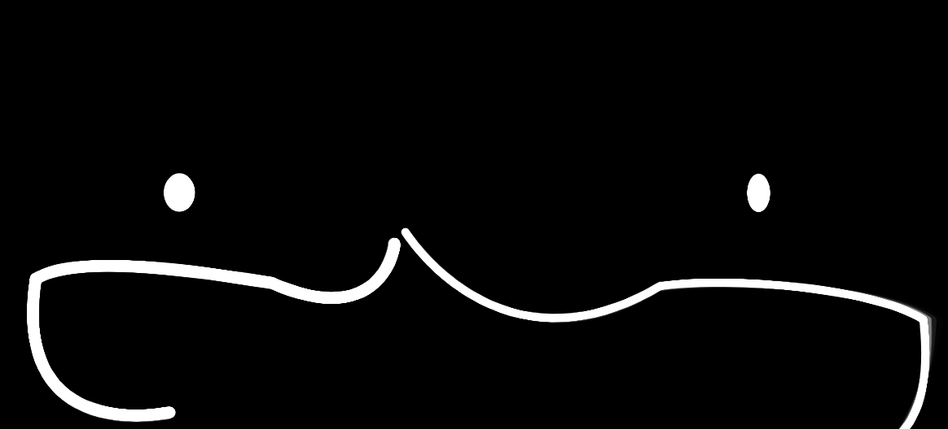
Bo-t Language
SCI 6365 | Foobot
Jessica Chen and Margaret Zhou

Slide 2
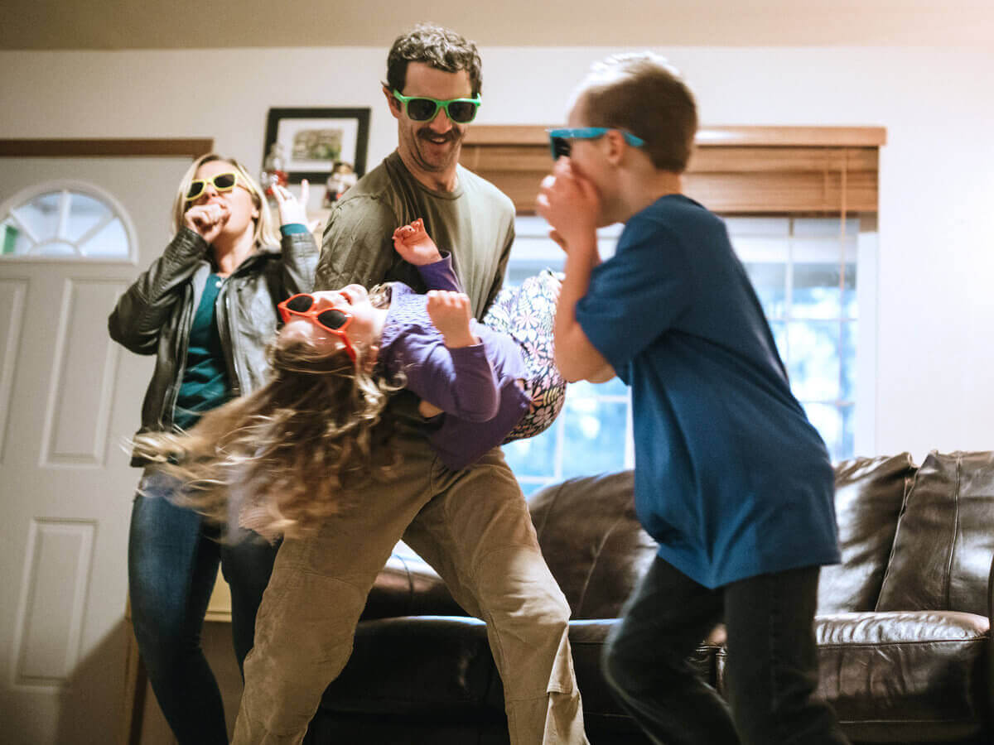


SCI 6365 | Foobot
Jessica Chen and Margaret Zhou

Slide 3
Project Statement
Body-to-body communication is one of a few powerful types of languages that transcend even our own human understanding of it. There is no textbook or guide that teaches us how to communicate or express via body movement - it’s innately built into our systems. The ability for music and rhythm to stir up movement is also instinctive. A tapping of the feet, nodding of the head, and swaying of the hips - humans were built to move. There’s nothing in the world that can replace having a dance party at home with a friend, family or loved one. It brings people together, allowing for a mutual understanding of freedom and enjoyment.
We wanted to build something that encouraged this communication - the feeling of being present with someone, sharing a moment of mutual understanding and expression. Sharing a dance.
SCI 6365 | Foobot
Jessica Chen and Margaret Zhou

Slide 4

Video
SCI 6365 | Foobot
Jessica Chen and Margaret Zhou

Slide 5


How it works:
Person 1
Party Host
Party Attendee
Person 2
Collects Data
Draws Figure 1
Sends Data
PoseNet Data
Audio Events
PoseNet Data
Audio Events
Draws Figure 1
Triggers Audio
Sender
Server
Client
Draws Figure 2
Triggers Audio
PoseNet Data
Audio Events
PoseNet Data
Audio Events
Collects Data
Draws Figure 2
Sends Data
SCI 6365 | Foobot
Jessica Chen and Margaret Zhou

Slide 6
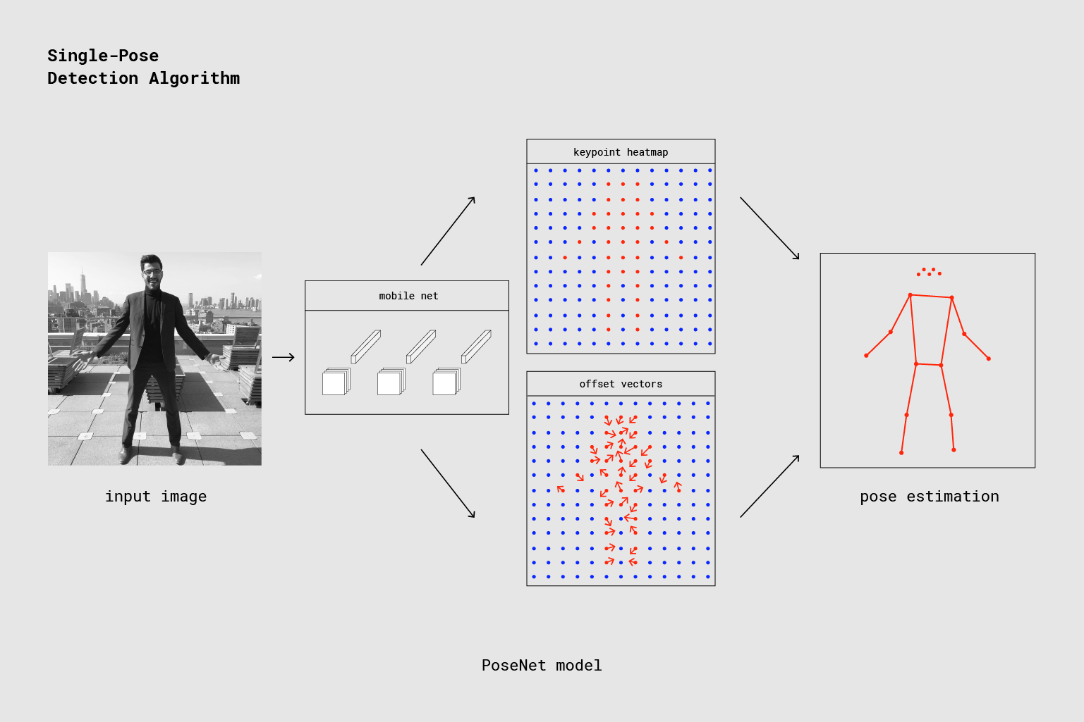
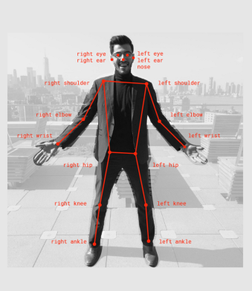
ML5: PoseNet
SCI 6365 | Foobot
Jessica Chen and Margaret Zhou

